Slide 1
Immigration Intensive Program
Jack Kim, Partner
February 2025

Slide 2


Jack Kim
Partner
Zohal Nassery
Articling Student

Slide 3
Provincial Nomination Programs
Overview
The T13 Work Permit
The Ontario Immigrant Nominee Program: How to Apply
Applicant/Employer Requirements
Recap
Procedural Fairness
Overview
Case Studies: : Adepoju and Hussein
Significance
Practice Tips: Avoiding and Addressing Refusals

Slide 4
Provincial Nomination Programs
Provincial nominee programs allow provinces and territories to nominate individuals based on the needs of their local labour market.
The program is designed for individuals that meet specific eligibility requirements related to their language proficiency, skills, education and work experience.
Each province has its own ‘stream’ that targets certain groups (for example, students, business people, skilled workers or semi-skilled workers).
Two ways to apply for Permanent Residence with a PNP: Express Entry vs Non Express Entry.

Slide 5

Direct Application (Non-Express Entry Route)
First, a candidate must meet the eligibility requirements for the specific stream they are applying under (ex: graduate, skilled worker, business owner)
The Applicant can directly apply to the province through its online application system. For the Ontario Immigrant Nominee Program (OINP), this means submitting an Expression of Interest (EOI) on their system.
If selected, the Applicant receives a provincial nomination certificate.
The Applicant can then use the provincial nomination certificate to submit the PR application directly to IRCC.
Processing Time: 20 months

Slide 6
EXPRESS ENTRY PROCESS
The Express Entry system is a points-based immigration selection system that manages applications for permanent residence based on three economic immigration programs
The Federal Skilled Worker Program
The Federal Skilled Trades Program
The Canadian Experience Class
Candidates are put into a ‘pool’ and ranked using the Comprehensive Ranking System, which assigns points based on factors such as age, education, foreign and Canadian work experience, language proficiency, and adaptability.
Under this process, the candidate must meet the eligibility requirements for one of the above Express Entry streams AND must qualify for the PNP stream of the province/territory they want to live in.
If a candidate is nominated by a province, they receive 600 CRS points, effectively guaranteeing an Invitation to Apply in the next Express Entry draw.
Processing Time: 6 Months

Slide 7
OINP
Employer Job Offer: Foreign Worker; International Student;, In-Demand Skills, Masters/PHD Graduate
Expression of Interest Streams
Express Entry Streams
Human Capital Priorities; Skilled Trades; French-Speaking Skilled Worker
Ontario Immigrant Nominee Program

Slide 8

OINP: A Closer Look
Employer Job Offer Stream:
Job offer for a full-time and permanent position (1,560 hours a year/ min 30 hrs a week)
In an eligible occupation (TEER 0,1,2 or 3 of the National Occupational Classification)
For the In-Demand Skills Stream, must be on the list of eligible occupations.
Wage must meet or exceed the prevailing wage for the specific region in Ontario
The position must be urgently necessary to the employer’s business and must primarily occur in Ontario
Human Capital Priorities Stream
Meet the requirements of either the FSW or CEC. No job offer required.
Work experience in an eligible occupation (TEER 0,1,2 or 3 of the National Occupational Classification)
Must have a Canadian bachelor’s, master’s or PhD or its equivalent (obtained through an ECA)
Language proficiency – CLB 7 or higher
Settlement funds

Slide 9
General Application Requirements
Applicant Documents:
Language test scores (IELTS, CELPIP, TCF)
Educational diplomas/transcripts and Educational Credential Assessments, if applicable.
Up to date resume/CV
Employment contracts and payslips
Updated financial documents
Copy of Canadian status documents
Intention to reside in the province/ties to the province (work experience, family/friends, real estate, education, volunteering)
Employer Documents:
Signed job offer
Employment Verification Letter, describing job duties, salary, position
Articles of Incorporation/ Business License
Company tax returns and financial documents, meeting minimum revenue requirements
Proof of physical operations in the province

Slide 10
THE T13 WORK PERMIT
Foreign nationals nominated by a province - Provincial Agreements (R204(c))
Work permit category under the International Mobility Program
Requirements: A valid nomination from a province (other than Quebec) for permanent residence; an LMIA-exempt offer of employment from an employer based in the province; and a provincial support letter indicating the urgent requirement for the foreign national to begin the job prior to permanent residence
The spouse or common law partner of the foreign national nominated under this category can also apply for an open work permit.

Slide 11
EXPRESS ENTRY PNP | NON-EXPRESS ENTRY PNP
Applicants create an Express Entry Profile If a province is interested, they will send the Applicant a Notification of Interest (NOI) Once a NOI is received, the Applicant may apply for a nomination through the province’s online application system Should the nomination be issued, the Applicant will receive 600 additional CRS points towards their EE Profile score Applicants can apply for PR once they receive an Invitation to Apply within the EE system ITA rounds for PNP candidates takes place every 2 weeks, on average | Applicants register a profile in the province’s online application system and are entered into a candidate pool (similar to Express Entry). NOTE: an Applicant can have a profile in one or both the provincial and the Express Entry application systems Once an Invitation to Apply to the province is received, an Applicant must complete and submit their application for PR within 45 days (for the OINP).
Recap of Different PR Application Processes

Slide 12
Procedural Fairness

Slide 13
Key Concepts
The right to know the case against them
The opportunity to respond
Transparency and fair decision-making processes
Duty to provide clear, intelligible reasons
Impartiality and avoidance of bias

Slide 14
CASE STUDY #1
Adepoju v. Canada (Citizenship and Immigration), 2024 FC 2014
JR of a refused work permit application
Required documents: General WP application documents + Nigeria-Specific Visa Office Requirements such as PCC, proof of property, evidence that they meet the requirements of the job offer (references, qualifications, certificates)
The Officer was not satisfied that the Applicant would be able to carry out the position offered as she did not provide pay slips or bank deposits to support her foreign work experience.
Holding: The onus is on the applicant to ‘put their best case forward’ and submit all relevant documentation. Duty of PF owed to such applicants is on the low end of the spectrum.

Slide 15
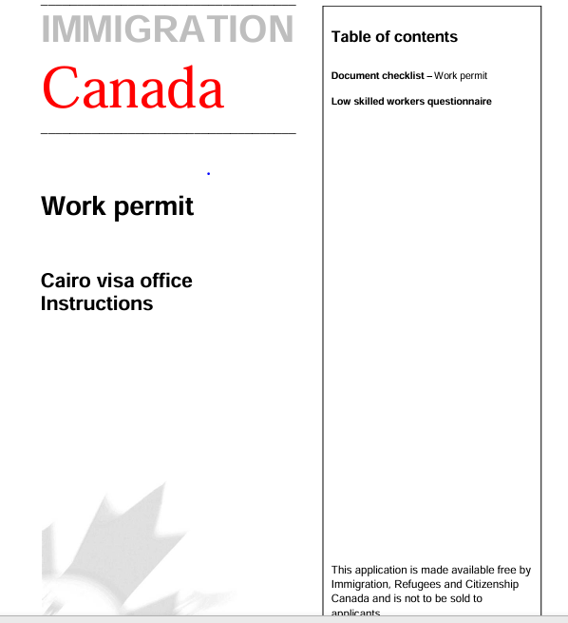
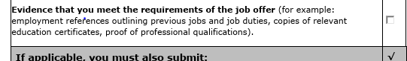
CASE STUDY #2
Hussein v. Canada (Citizenship and Immigration), 2024 FC 1629
JR of a refused work permit/visitor visa application
Required documents: General WP application requirements + T13 work permit requirements (job offer from province that nominated you, proof of provincial nomination) + Egypt Visa Office requirements* (evidence that they meet the requirements of the job offer)
The applications were denied due to misrepresentation and a negative credibility finding due to the applicant’s failure to disclose prior visa refusals from the US and Brazil. Applicants argued that omission was innocent mistake and provided affidavits and requested an interview in case of credibility concerns, which the Officer rejected.
Holding: The Officer breached their duty of procedural fairness because he did not provide the Applicants with notice of his credibility concerns and failed to address the applicants’ explicit request for an interview
*https://www.canada.ca/en/immigration-refugees-citizenship/services/application/application-forms-guides/apply-work-permit-outside-canada.html

Slide 16
Significance
Applicants are expected to put their best case forward and cannot rely on extensive procedural safeguards
While procedural fairness obligations are on the low end of the spectrum, cases involving findings of misrepresentation may heighten procedural fairness considerations due to the significant repercussions involved
Effect on practice: The low bar of procedural fairness → “kitchen sink” applications → client service issues

Slide 17
Significance
The burden is on the applicant to put forward a thorough and complete application.
Duty of candor to tell the truth and not conceal facts AND a duty to support their applications with documents that support their position(s).
Visa officers are not obligated to request additional information where the submitted information is insufficient.
However, when there are concerns about the credibility of the evidence, rather than its sufficiency, then the duty of fairness may be invoked and requires that the applicant be provided an opportunity to address the concern.

Slide 18
Practice Tips
Avoiding refusals → reviewing supporting documents and ensuring client meets all eligibility criteria; addressing gaps or inconsistencies and avoiding errors or omissions
→ Doing a completeness check
→ Incomplete applications are rejected and returned
Addressing refusals → determine the best cause of action and whether the officer made a credibility assessment.
Note: Credibility assessments are often implicit/veiled as opposed to explicit.
→ ATIP for GCMS notes; submitting a webform; reconsideration requests, appeals, or judicial reviews

Slide 20
THANK YOU

